Slide 1

Java Programming
Exceptions
异常

Slide 2
Correctness & robustness
A program is correct(正确) if it accomplishes the task that it was designed to perform.
It is robust(健壮) if it can handle exceptions( e.g. illegal inputs or other unexpected situations) in a reasonable way.

Slide 3
Outline
Exception
Exception handling
Exception Classes
Checked vs. Unchecked Exceptions
Exception & callstack
Create your own exception

Slide 4
Exception(异常)
An exception is an abnormal event that arises during the execution of the program and disrupts the normal flow of the program.
If these exceptions are not handled properly, the program terminates abruptly and may cause severe consequences.
For example,
the files may remain opened; file records may be left in an inconsistent state.

Slide 5
Drawbacks of exception handling in older languages
Scenario:
suppose the programmer wishes to open a file for processing
Three cases:
The programmer is not aware of the exceptional conditions.
For example, the file to be opened may not necessarily exist. The programmer therefore did not write codes to test whether the file exists before opening the file.
Suppose the programmer is aware of the exceptional conditions, he/she might decide to finish the main logic first, and write the exception handling codes later – this "later", unfortunately, usually never happens.
In other words, you are not force to write the exception handling codes together with the main logic.
Suppose the programmer decided to write the exception handling codes, the exception handling codes intertwine with the main logic in many if-else statements.
This makes main logic hard to follow and the entire program hard to read.

Slide 6
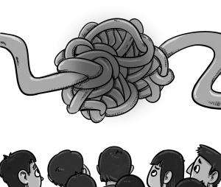
Intertwined codes (纠缠代码)
if (file exists) {
open file;
while (there is more records to be processed) {
if (no IO errors) {
process the file record
} else {
handle the errors
}
}
if (file is opened) close the file;
} else {
report the file does not exist;
}

Slide 7
Exception handling in Java
Java overcomes these drawbacks by building the exception handling into the language rather than leaving it to the discretion of the programmers:
You will be informed of the exceptional conditions that may arise in calling a method - Exceptions are declared in the method's signature.
You are forced to handle exceptions while writing the main logic and cannot leave them as an afterthought - Your program cannot compiled without the exception handling codes.
Exception handling codes are separated from the main logic - Via the try-catch-finally construct.
This is to ensure that you can write robust programs for mission-critical applications.

Slide 8
Exception handling in Java
Exception Handling Operations
Five keywords: try, catch, finally, throws and throw
Exception Handling Code template
try {
// main logic, uses methods that may throw Exceptions
......
} catch (Exception1 ex) {
// error handler for Exception1
......
} catch (Exception2 ex) {
// error handler for Exception2
......
} finally { // finally is optional
// clean up codes, always executed regardless of exceptions
......
}

Slide 9
Separation of concerns(分离关注)
The main logic is separated from the exception handling codes
import java.util.Scanner;
import java.io.File;
import java.io.FileNotFoundException;
public class ScannerFromFileWithCatch {
public static void main(String[] args) {
try {
Scanner in = new Scanner(new File("test.in"));
// your main logic
} catch (FileNotFoundException ex) {
ex.printStackTrace(); // exception handling
}
}
}

Slide 10
Separation of concerns
If you decide not to handle the exception in the current method, you can throw the exception up the call stack for the next higher-level method to handle.
import java.util.Scanner;
import java.io.File;
import java.io.FileNotFoundException;
public class ScannerFromFileWithThrow {
public static void main(String[] args) throws FileNotFoundException {
// to be handled by next higher-level method
Scanner in = new Scanner(new File("test.in"));
// main logic here ...
}
}

Slide 11
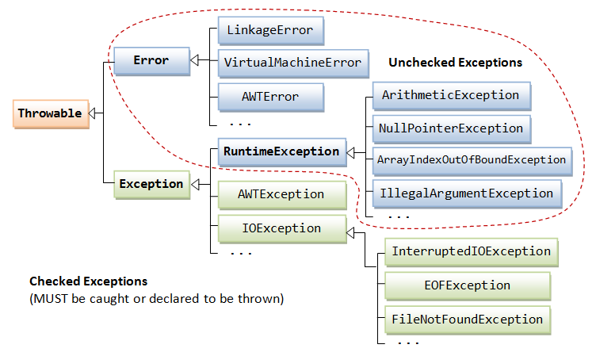
Exception Classes
https://docs.oracle.com/javase/tutorial/essential/exceptions/

Slide 12
Error vs Exception
The Error class
describes internal system errors (e.g., VirtualMachineError, LinkageError) that rarely occur.
If such an error occurs, there is little that you can do and the program will be terminated by the Java runtime.
The Exception class
describes the error caused by your program (e.g. FileNotFoundException, IOException).
These errors could be caught and handled by your program (e.g., perform an alternate action or do a graceful exit by closing all the files, network and database connections).

Slide 13
Checked vs. Unchecked Exceptions
checked exceptions
They are checked by the compiler and must be caught or declared to be thrown.
unchecked exceptions
These exceptions are not checked by the compiler, and hence, need not be caught or declared to be thrown in your program.
This is because there is not much you can do with these exceptions.
If these exceptions are nor caught by any method, the program will be terminated by the Java runtime.

Slide 14
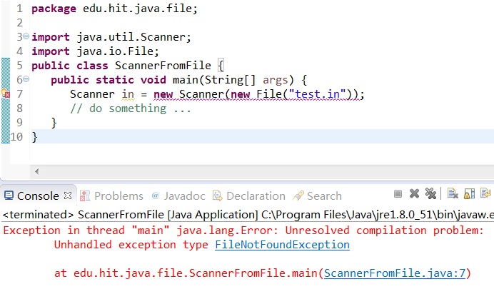
Checked Exceptions
If a method declares an exception in its signature, you cannot use this method without handling the exception - you can't compile the program.
import java.util.Scanner;
import java.io.File;
public class ScannerFromFile {
public static void main(String[] args) {
Scanner in = new Scanner(new File("test.in"));
// do something ...
}
}

Slide 15
Checked Exceptions
A checked exception must be either caught or declared in the method in which it is thrown.
As an example, the signature of the Scanner's constructor with a File argument is given as follows:
public Scanner(File source) throws FileNotFoundException;
By declaring the exceptions in the method's signature, programmers are made to aware of the exceptional conditions in using the method.

Slide 16
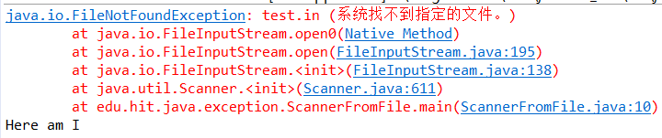
Catching the Checked Exceptions
import java.util.Scanner;
import java.io.File;
import java.io.FileNotFoundException;
public class ScannerFromFile {
public static void main(String[] args {
try{
Scanner in = new Scanner(new File("test.in"));
System.out.println(“opening file!”); //not be executed
}catch(FileNotFoundException e){
e. printStackTrace();
}
System.out.println(“Here am I”);
}
}

Slide 17
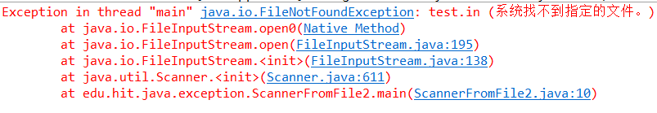
Throwing Checked Exceptions
import java.util.Scanner;
import java.io.File;
import java.io.FileNotFoundException;
public class ScannerFromFile2 {
public static void main(String[] args) throws FileNotFoundException {
Scanner in = new Scanner(new File("test.in"));
System.out.println(“opening file!”);
}
}

Slide 18
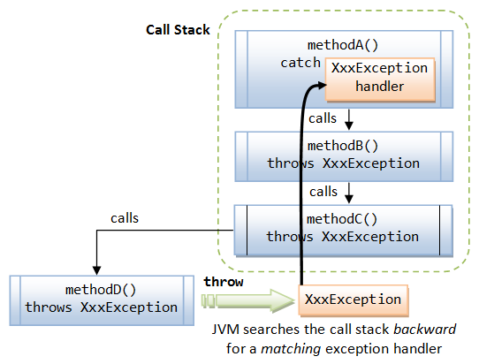
Exception & Call Stack
if a method throw an Exception, the JVM is responsible for finding an exception handler.
It searches backward through the call stack until it finds a matching exception handler.
Note: that methodC() and methodB() are required to declare "throws XxxException" in their method signatures

Slide 19

Unchecked Exceptions
public class Calculator {
public static void main(String[] args) {
System.out.println(“The result is”+devide(1,0));
}
public static int devide(int divisor, int dividend) {
// This may trigger an ArithmeticException - an unchecked exception
return divisor/dividend;
}
}
What’s the output?

Slide 20

Unchecked Exceptions
public class Calculator {
public static void main(String[] args) {
System.out.println(“The result is”+devide(1,0));
}
public static int devide(int divisor, int dividend) {
// This may trigger an ArithmeticException - an unchecked exception
try {
return divisor/dividend;
} catch (ArithmeticException e) {
return 999999; // suppose that 999999 means / zero error!
}
}
}
What’s the output?

Slide 21
Finally block
If no exception occurs during the running of the try-block, or all the catch-blocks are skipped, and finally-block will be executed after the try-block.
The finally block is almost certain to be executed, regardless of whether or not exception occurs (unless JVM encountered a severe error or a System.exit() is called in the catch block).

Slide 22

Unchecked Exceptions
public class Calculator {
public static void main(String[] args) {
System.out.println(“The result is ”+devide(1,0));
}
public static int devide(int divisor, int dividend) {
try {
return divisor/dividend;
} catch (ArithmeticException e) {
return 999999; // suppose that 999999 means / zero error!
} finally {
System.out.println("finally block executed!");
}
}
}
What’s the output?

Slide 23

Unchecked Exceptions
public class Calculator {
public static void main(String[] args) {
System.out.println(“The result is”+devide(1,0));
}
public static int devide(int divisor, int dividend) {
try {
if(dividend==0)System.exit(-1);
return divisor/dividend;
} finally {
System.out.println("finally block executed!");
}
}
}
What’s the output?

Slide 24
Creating Your Own Exception
public class MyIllegalArgumentException extends Exception {
public MyIllegalArgumentException(String message) {
super(message);
}
}

Slide 25
throwing Exception
public class Calculator {
public int devide(int divisor, int dividend) {
//check the dividend
if(dividend == 0) {
throw new MyIllegalArgumentException ("Dividend can’t be zero!");
}
return divisor/dividend;
}
public static void main(String[] args) {…}
}

Slide 26
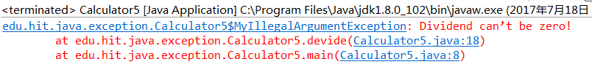
Creating Your Own Exception
public static void main(String[] args) {
Calculator c= new Calculator();
try {
System.out.print(c.devide(1,0));
} catch (MyIllegalArgumentException e) {
e.printStackTrace();
}
}
What’s the output?

Slide 27
Suggestion
When you program in Java, you must position catchers (the exception handlers) strategically, so your program will catch and handle all exceptions from which you want your program to recover.

Slide 28


